Slide 1
Retail Sales Prediction
on Ecommerce and Mail Order by Machine Learning Models
Group 7a - Presenters:
Ge Zhang gz2262@columbia.edu
Ziwei Guo zg2278@columbia.edu Xiaorong Yuan xy2347@columbia.edu
Shiyu Liu sl4258@columbia.edu
Jianfeng Zhang jz2857@columbia.edu
Jiarui Tian jt2995@columbia.edu
Jing Ye jy2878@columbia.edu

Slide 2
Executive Summary
Ge Zhang
Mission: Our team will implement different machine learning techniques to predict retail sales of electronic shopping and mail-orders and evaluate which methods perform much better.
Thesis: Whether machine learning technique could improve the accuracy of ecommerce sales prediction
In order to effectively predict retail sales of electronic shopping and mail-orders, electronic shopping and mail-order houses sales return monthly data from 1992 to 2017 was used to determine next few years sales, in terms of economic and social factors.
Our completed project consists of basic business and data understanding, 5 R-based machine learning models, and followed by performance and evaluation of models.

Slide 3
Key Points
Ge Zhang
Predictors: non-seasonally adjusted GDP, CPI, 3-Month Treasury Constant Maturity Rate, PMI, Unemployment, Crude Oil Price, Industrial Production Index, Total Nonfarm Payroll, two Holidays and the Super Bowl
Time: 3-month lag (economic indicators)
Holidays: Thanksgiving, Christmas and a social event, Super Bowl
Data modeling: Ordinary Least squares, Lasso/Ridge, Generalized Additive Models, Regression Trees, Support Vector Regression
Model Performance: R-squared and mean squared error
Notes:
Using 3-month lag because lag of release of economic indicators

Slide 4
Data Limitation
Ge Zhang
Data Limitation and Credentials:
When adding predictive variables into the model initially, many of the predictors involve credentials, of which the impossibility of access led to an unpreventable drop in variable size. The limitation of data access may have impacted the performance of many machine learning techniques, which are best used for variable shrinkage
Judgmental Bias:
The methods and variables to use are consulted and based on machine learning researches on sales data in the past, all data that are accessible and considered potentially contributive are added. By selecting the variables to include, a human subjective view is applied and thus may result in a loss of important yet uncommonly used predictors. The loss in a judgmental bias is inevitable yet influential in machine learning techniques appliance.

Slide 5
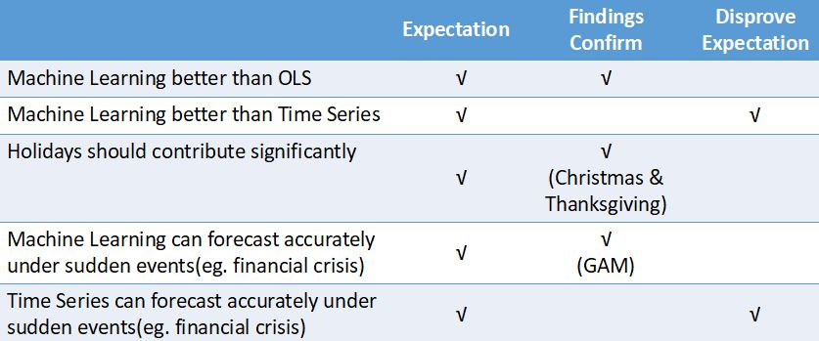
Expectation
Ziwei Guo
Expectation:
Compare different machine learning models with OLS to generate a more accurate model;
Compare best-performing machine learning method with time series forecasting model;
Generate predictors which should predict the trend of sales powerfully and effectively indicates potential crisis.
B. Findings Confirmation & Disprove Expectation

Slide 6
Business Understanding
Business Reference Baseline
Ziwei Guo
Data:
Dependent Variables: SpringML offers an app which simplifies forecasting for an individual company by executing machine learning models. Their models include intrinsic predictors and external variables.
Models:
Explaining Machine Learning Models in Sales Predictions (by Marko Bohanec), the top performing machine learning models (such as random forest, support vector machines and neural networks) achieve significantly better predictive performance than simple models (such as decision tree and Naive Bayes).
Trading Economics provides United States retail sales excluding automobile section forecasts over a period of a month using ARIMA model. They utilize sales data from 1992 up to now in the form of percentage to predict monthly sales’ change rate.

Slide 7
Statistical Value-add
Ziwei Guo
Data:
Dependent Variables: Since this project is aimed at predicting sales of the whole nation, macroeconomic leading indicators are included in models which could provide an overview picture of domestic economic dynamics.
Models: By contrasting, this project combines machine learning models and time series analysis (Seasonal ARIMA).
Firstly, compare models generated by Generalized Additive Models, Regression Tree, Linear and Nonlinear Support Vector Regression with OLS, and conclude that GAM performs best.
Then, compare the results during financial crisis between GAM and time series analysis. It turns out that GAM performs better.

Slide 8
Business Value-add
Ziwei Guo
Independent variable is Retail Sales of Electronic Shopping and Mail-Orders (Sales). It comprises establishments primarily engaged in retailing all types of merchandise using non-store means, such as books and magazines, clothing and accessories, computer hardware and software, drugs, etc. The independent variable can be helpful for firms’ decision making.
Predictors of the most importance generated by best performance model,GAM, are Christmas, Thanksgiving, CPI, Crude Oil and Unemployment rate.
When forecasting retail sales normally, time series would be closer to true value than GAM. However, when predicting retail sales during financial crisis (eg 2008), machine learning method, GAM, performs much better than time series analysis, which returns a more accurate forecast.

Slide 9
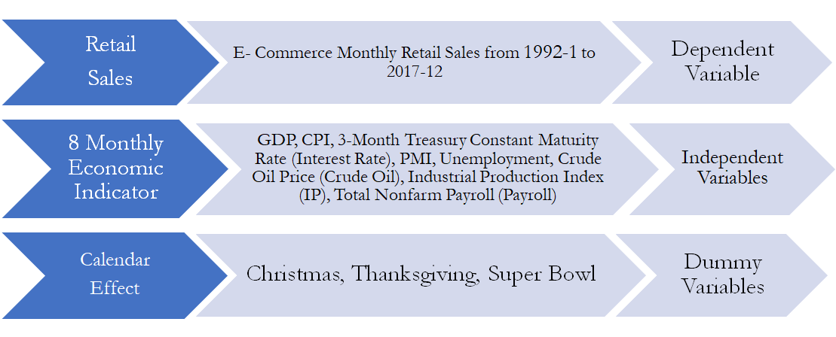
Data Understanding
Data Collection and Cleaning
Xiaorong Yuan
•Data Collection
Find historical data about National E-commerce Retail Sales and 8 common
economic indicators during the same period

Slide 10
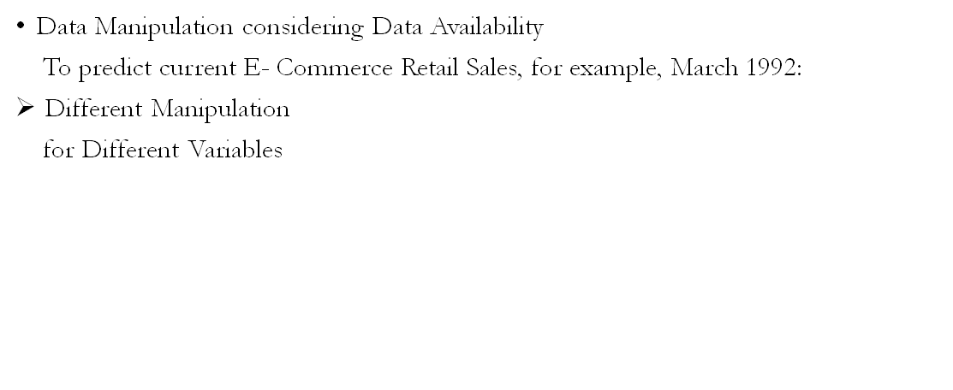
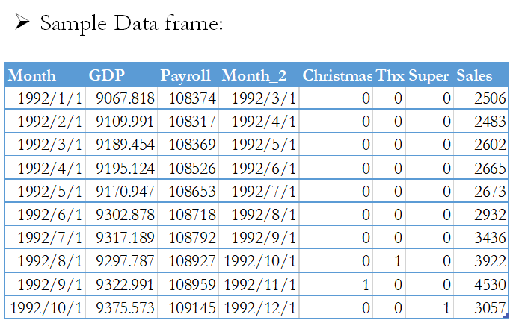
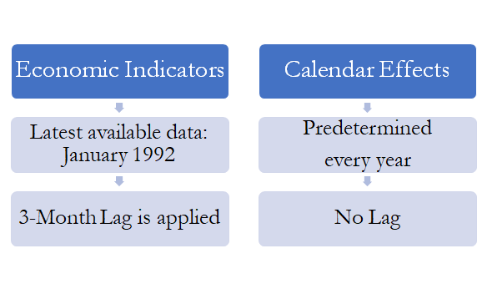
Data Manipulation Using Time Lag
Xiaorong Yuan

Slide 11
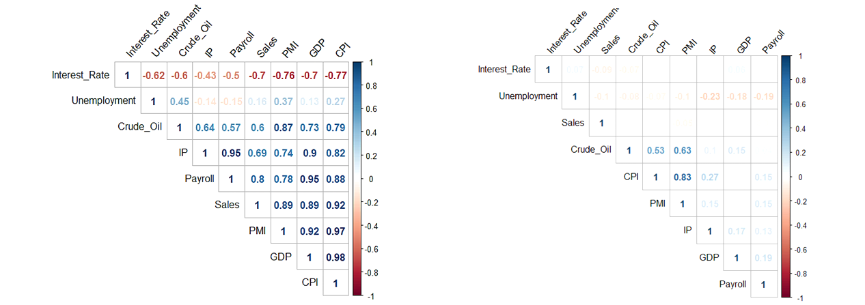

Data Differencing
Xiaorong Yuan
Calculate change in percentage of each economic indicators and responses
Corresponding Business Understanding
Explore the relationship among changes
Reduce correlation among variables

Slide 12
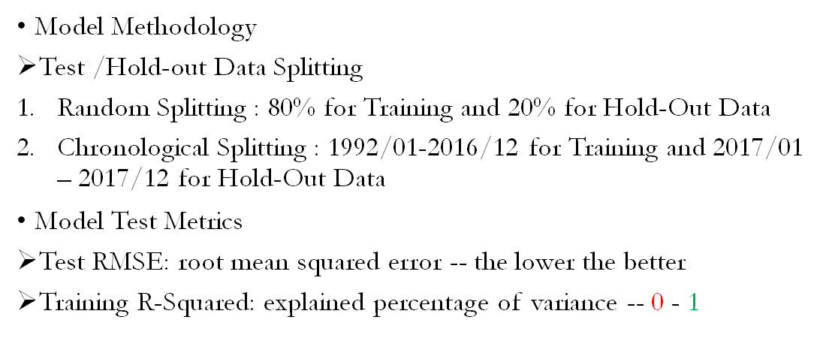
Cross Validation Methodology
Xiaorong Yuan

Slide 13
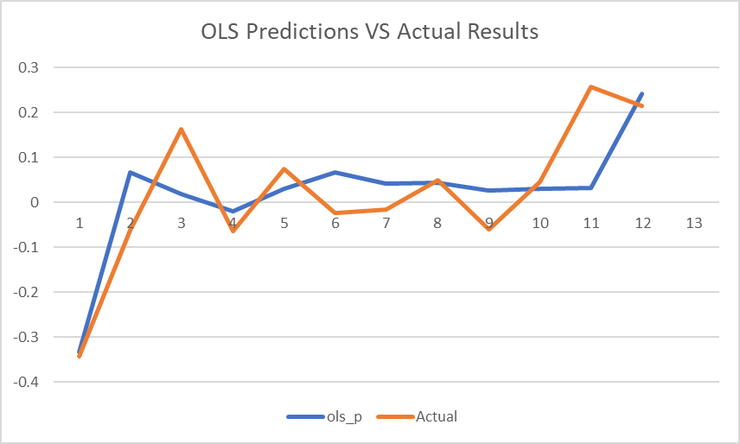
Model Methodology
Linear Models
Shiyu Liu
OLS (Baseline)
Use All Variables Available
80/20 splitting
Test RMSE = 0.1016
Test R^2 = 0.6464
Chronological Splitting
Test RMSE = 0.0829
Test R^2 = 0.1637

Slide 14
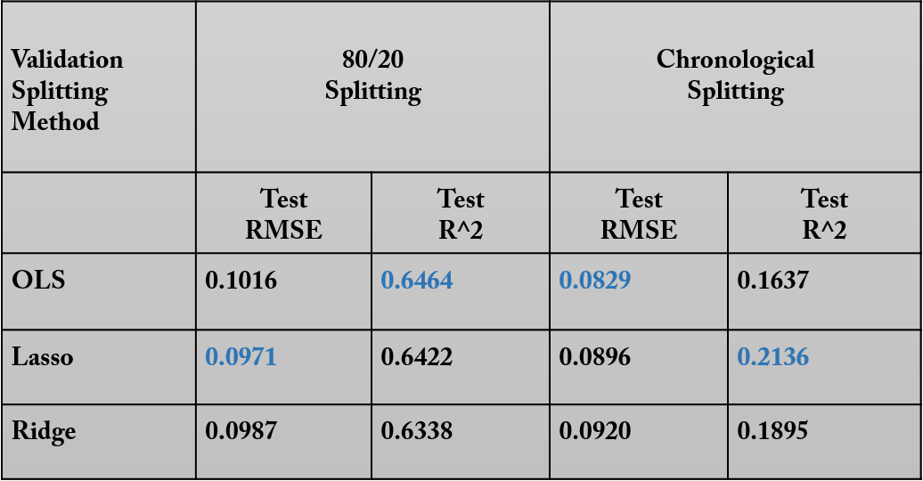
Reduce Variance: Lasso and Ridge Regression
Shiyu Liu
Remaining Variables:
Christmas
Thanksgivings
Super Bowl
CPI
Unemployment Rate
GDP

Slide 15
Beyond Linearity: GAM
Shiyu Liu
80/20 : Test RMSE = 0.0124
Test R^2= 0.6990
25/1 : Test RMSE = 0.0109
Test R^2 = 0.54706
Degrees of Freedom:
Flexibility Measurement
Submodel:
Smoothing spline
Variable Names | GDP | CPI | Interest Rate | PMI | Unemployment | Crude Oil Price | IP | Payroll
Degrees of Freedom | 2.05 | 3.03 | 4.55 | 3.93 | 2.57 | 2.07 | 20.312 | 2.36

Slide 16
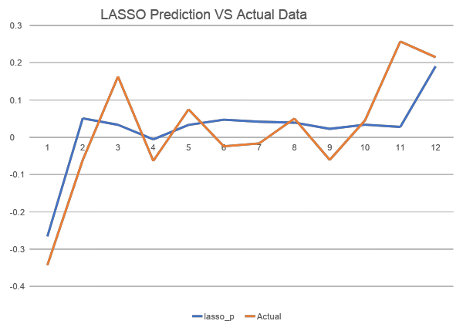
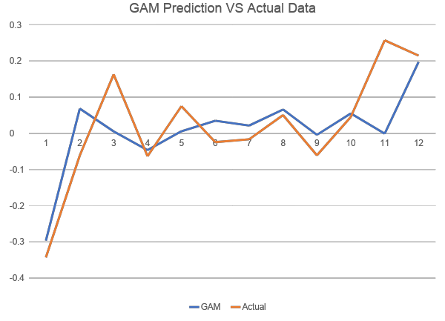
GAM VS Linear Methods: Value Added!
Shiyu Liu
Chronological Splitting Test Set : OLS RMSE = 0.0829 LASSO RMSE = 0.0971, GAM RMSE = 0.0109

Slide 17
SVM
Jianfeng Zhang
To minimize the error and individualize the hyperplane which maximizes the margin.
Applied Tune method with the 5-fold cross validation to find best parameters
The margin will be wide and the model will perform better with Small cost value.

Slide 18
SVM(Results)
Jianfeng Zhang
 | Linear | Radial
Training R-squared | 64.4% | 84.0%
Testing R-squared | 72.8% | 73.3%
Testing RMSE | 0.085 | 0.084
80%/20%
 | Linear | Radial
Training R-squared | 67.7% | 86.7%
Testing R-squared | 63.1% | 70.0%
Testing RMSE | 0.0918 | 0.083
25yr/1yr

Slide 19
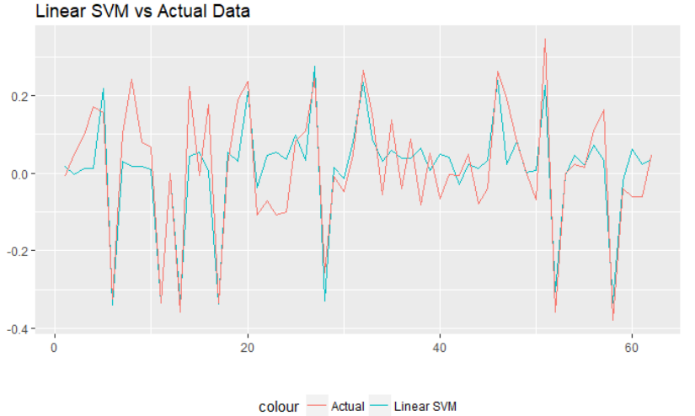
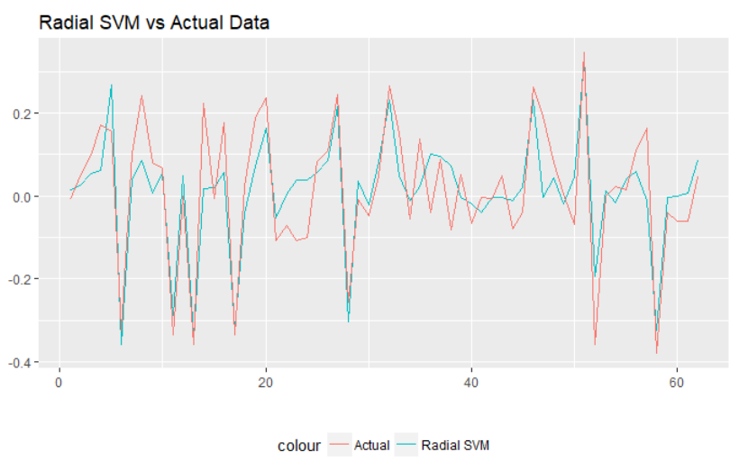
Test Values vs Actual values
Jianfeng Zhang

Slide 20
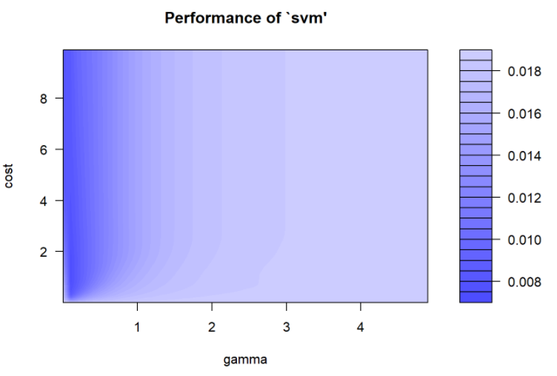
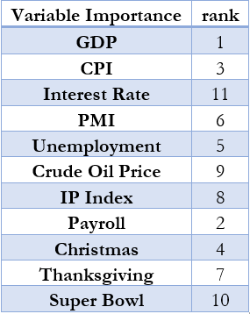
SVM(radial)
Jianfeng Zhang

Slide 21
Regression Tree & Random Forest
Jiarui Tian
As mentioned previously, two sets of data were used in the model
80/20 : Randomly Sample 80:20 data into training/testing
25/1 : Use First 25-year data (296 months) to predict 1-year (12 month)
Data
Tree
Regression Tree takes little model assumption, and thus the return data needs no further preprocessing
It is however very sensitive to data and therefore unstable
Random
Forest
Random Forest is use to provide an ensemble and stabilize the model results
5-fold cross-validation is performed in both tree & random forest for parameter pruning

Slide 22
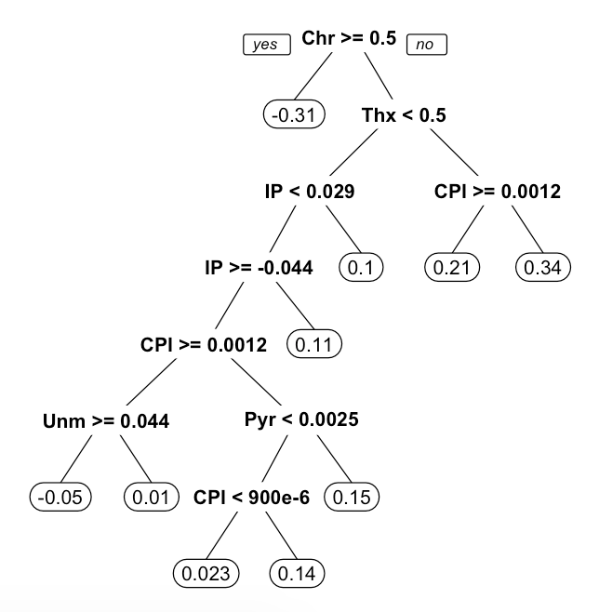
Regression Tree
Jiarui TIan
80/20
Final Variables: CPI, IP, Unemployment, Thanksgiving, Christmas
Training R-squared: 76.9%
Testing R-squared: 58.7%
Testing RMSE: 0.083
25/1
Final Variables: CPI, IP, Unemployment, Payroll, Thanksgiving, Christmas
Training R-squared: 65.1%
Testing R-squared: 62.2%
Testing RMSE: 0.081

Slide 23
Random Forest
Jiarui TIan
Final Variables:
Most Useful: Christmas & Thanksgiving
Others: IP, CPI, Unemployment, GDP
The remaining has very little contribution
Training R-squared: 69.5%
Testing R-squared: 71.2%
Testing RMSE: 0.081
80/20
25/1
Final Variables:
Most Useful: Christmas & Thanksgiving
Others: IP, CPI, Unemployment, Payroll , Interest Rate
Training R-squared: 72.1%
Testing R-squared: 55.8%
Testing RMSE: 0.075

Slide 24
Technical Appendix for Machine Learning Models
Jiarui TIan
OLS
After taking the Sales return, no further correlation tests were made. Linear Regression was built directly for the 11 variables
On top of OLS, 5-fold cross-validation was made to tune λ, the shrinkage parameter
Smoothing spline is applied to fit the data
Cross-validate on training data to find the best degrees of freedom in each sub-model
For regression tree, training model is first built to select the variables used, and cross-validate complexity parameter which determines the improvements of each split
For random forest, cross-validate the # of variables randomly chosen in each split
Applied tune method with Cross-validate on training data to find the best parameters
Used Rminer package to find the relative importance for each variable in the selected model
Ridge Lasso
GAM
Tree Forest
SVM

Slide 25
Evaluation for Machine Learning Models
Ye Jing
Evaluation
Random Split (80％/20％)
 | Training R2 | Test RMSE | Rank by Test RMSE
GAM | 0.7783 | 0.0124 | 1
RandomForest | 0.6945 | 0.0808 | 2
OLS | 0.6873 | 0.0829 | 3
Tree | 0.7690 | 0.0836 | 4
SVM(radial) | 0.8403 | 0.0844 | 5
SVM(linear) | 0.6437 | 0.0852 | 6
Lasso | 0.6776 | 0.0896 | 7
Ridge | 0.6792 | 0.0920 | 8
Chronological Split (25yr/1yr)
 | Training R2 | Test RMSE | Rank of Test RMES
GAM | 0.7888 | 0.0109 | 1
RandomForest | 0.7206 | 0.0746 | 2
Tree | 0.6514 | 0.0806 | 3
SVM(radial) | 0.7003 | 0.0827 | 4
SVM(linear) | 0.6312 | 0.0917 | 5
Lasso | 0.6865 | 0.0971 | 6
Ridge | 0.6889 | 0.0987 | 7
OLS | 0.6950 | 0.1016 | 8
Non-linear
Linear
GAM model’s performance stay the best.
Non-linear Models outperform Linear ones, especially in Chronological Split.

Slide 26
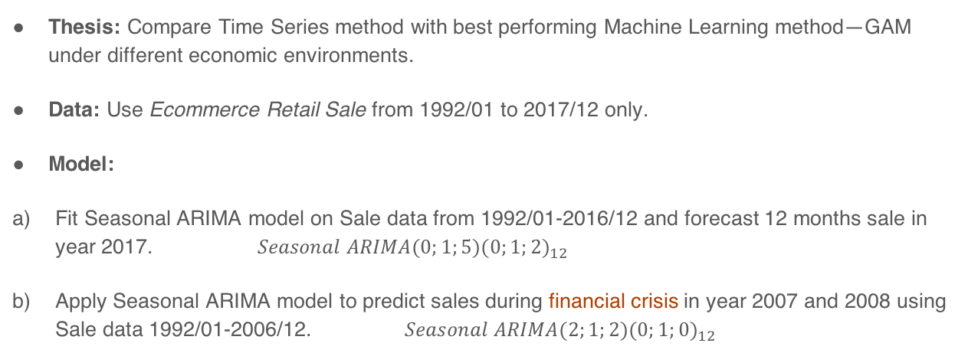
Time Series Forecasting Model
Ye Jing

Slide 27
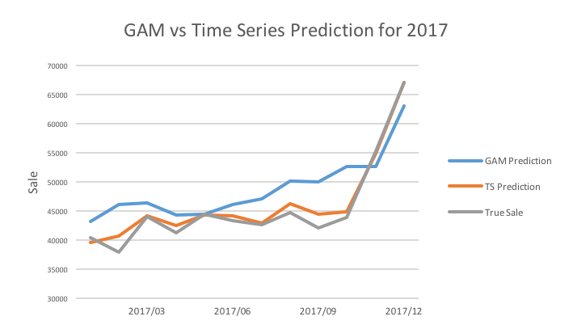
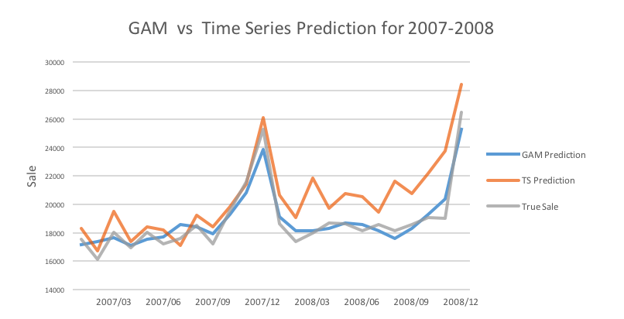
Comparison between Time Series and GAM
Ye Jing
Time Series RMSE: 1297.379
GAM RMSE: 5089.079
Time Series RMSE: 1976.310
GAM RMSE: 688.991
Time Series Model performs well in 2017, but fails to predict trend during the financial crisis 2007-2008; while GAM catches the signal relatively well.
Value Add: Machine learning method can flexibly adapt to the change in financial environment.

Slide 28
Technical Appendix for Time Series Model
Ye Jing
Step 1: Do a time series plot of the data. Examine it for features such as trend and seasonality.
Step 2: Do any necessary differencing, both on trend and seasonality. First apply seasonal difference to data and then re-evaluate the trend. If a trend remains, then take first difference.
Step 3: Determine possible models by applying auto.arima(), choosing the parameters by minimizing the AIC.
Step 4: Examine the residuals for the fitted model.
Step 5: Use the fitted time series model to forecast sale.

